Slide 1
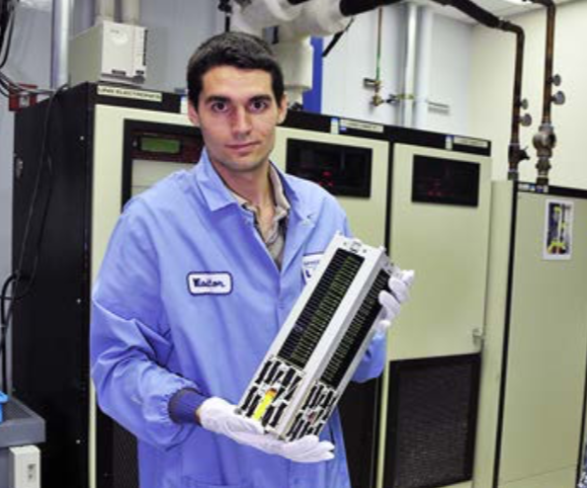
CubeSats
Invented in 1999
Standardized units (1U, 3U, etc.)
Academic, Commercial, Government, International

Slide 2
CubeSat Applications
Scientific missions
Astronomy
Inferometry
Interplentary
Government Missions
SATCOM
Earth observation
Commercial Missions
Inter-satellite links
Planet Imagery

Slide 3
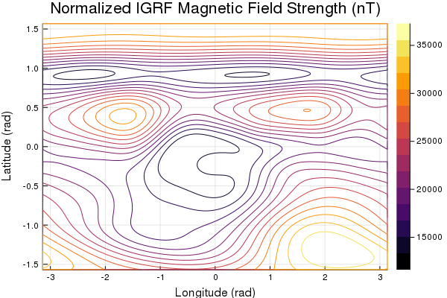
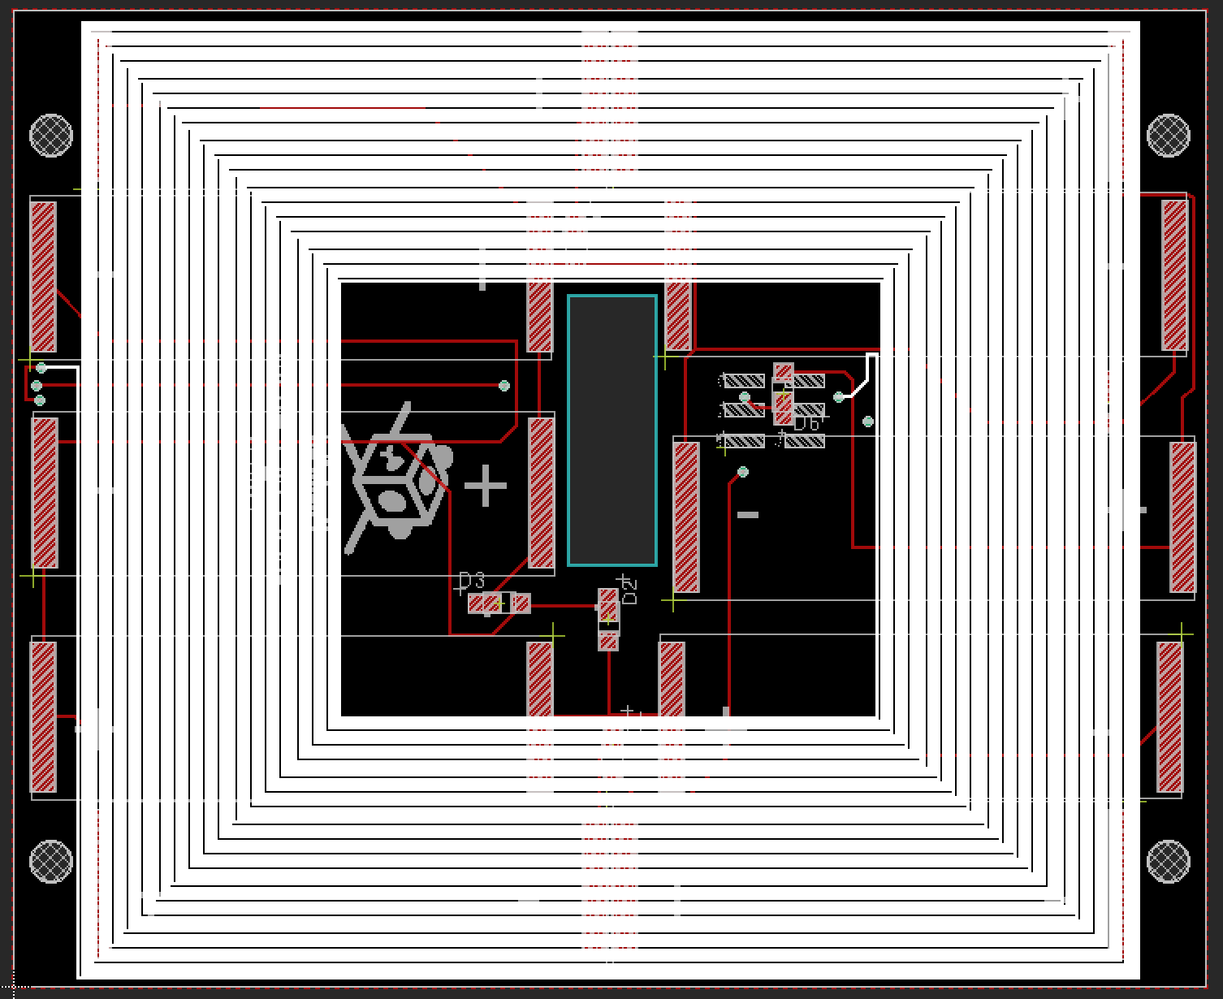
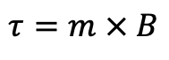
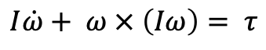
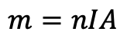
Magnetorquer-only ADCS
Detumbling
IGRF magnetic field model
Trajectory optimization
$$I\dot{ω}+ ω × \left(Iω\right)= τ$$
$$τ=m × B$$
$$m=nIA$$
Solar Panel Magnetorquer
Magnetic Field
Notes:
Can only not control along track, which doesn’t really matter
Equatorial tracking of ground station hard maybe impossible

Slide 4
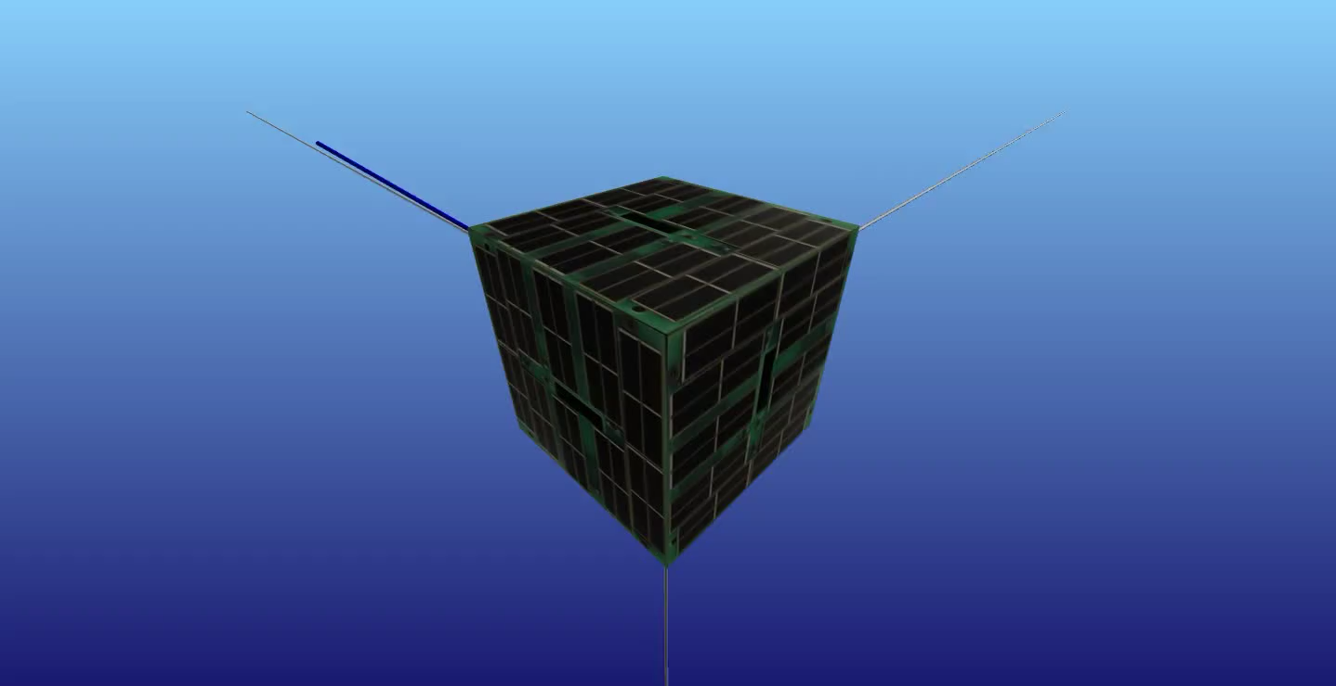
No jitter
Arbitrary orbit
Combined with other methods – complete attitude control!

